Slide 1

Hadoop
Cloudera
Trainer:- Deep Pandey

Slide 2
Hardware and Software Requirements

Slide 3
NODES
Nodes
Master
Nodes
NameNode
Secondary NameNode
Slave
Nodes
Data Node
Job Tracker
Task Tracker

Slide 4
HARDWARE REQUIREMENTS
MASTER NODES
4–6 1TB hard disks in a JBOD configuration (1 for the OS, 2 for the FS image [RAID 1], 1 for Apache ZooKeeper, and 1 for Journal node)
2 quad-/hex-/octo-core CPUs, running at least 2-2.5GHz
64-128GB of RAM
Bonded Gigabit Ethernet or 10Gigabit Ethernet

Slide 5
HARDWARE REQUIREMENTS
SLAVE NODES
12-24 1-4TB hard disks in a JBOD (Just a Bunch Of Disks) configuration
2 quad-/hex-/octo-core CPUs, running at least 2-2.5GHz
64-512GB of RAM
Bonded Gigabit Ethernet or 10Gigabit Ethernet (the more storage density, the higher the network throughput needed)

Slide 6
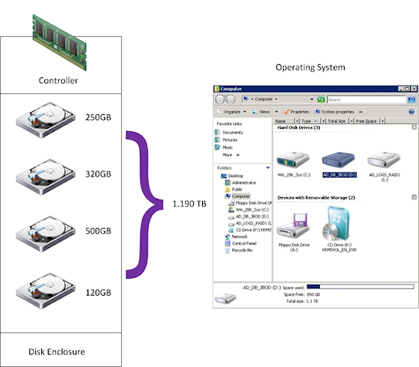
JBOD
Either a single or number of disks which are grouped together and presented to the Operating System as a single volume
No resilience applied in this configuration - e.g. if you lose a single disk in the JBOD then there is a high likelihood that you will lose data, as the concept of a JBOD does not include not fault tolerance

Slide 7
SOFTWARE REQUIREMENTS
Red Hat-compatible systems
Red Hat Enterprise Linux 5.7 and CentOS 5.7, 64-bit
Red Hat Enterprise Linux 6.2 and 6.4, and CentOS 6.2 and 6.4, 64-bit
Oracle Enterprise Linux 5.6 with Unbreakable Enterprise Kernel, 64-bit
SLES systems
SUSE Linux Enterprise Server 11, 64-bit. Service Pack 1 or later is required. Also, the SUSE Linux Enterprise Software Development Kit 11 SP1 is required on cluster hosts running the Cloudera Manager Agents (not required on the Cloudera Manager Server host);
Debian systems
Debian 6.0 (Squeeze), 64-bit
Ubuntu systems
Ubuntu 10.04 (Lucid Lynx), 64-bit
Ubuntu 12.04 (Precise Pangolin), 64-bit

Slide 8
Tea Break

Slide 9
Package Installation

Slide 10
Advantages
SIMPLICITY:- Files and directories are guaranteed to have correct permissions.
CONSISTENCY:- Files and Directories are installed according to the Filesystem Hierarchy Standard; Configuration files are in /etc/hadoop, logs in /var/log/hadoop, executables in /usr/bin etc.
INTEGRATION:- It is easy to integrate a Hadoop installation with configuration management packages like chef and puppet since Hadoop can now be installed just like other software packages.
VERSIONING:- As newer versions of Hadoop are related, the process of upgrading the software on disk can be deferred to the package manager

Slide 11
Important Paths
/etc/hadoop :- Hadoop configuration files. The equivalent of the conf directory in the tarball.
/etc/init.d :- init script for each hadoop daemon.
/usr/bin :- Main Hadoop executable as well as the task-controller binary.
/usr/lib :- C Libraries for hadoop
/usr/libexec :- Miscellaneous files used by various libraries and scripts that come with Hadoop
/usr/sbin :- Helpr shell scripts used by administrators of hadoop are installed here.
/usr/share/doc/hadoop :- License, NOTICE and README fiiles.

Slide 12
Lunch Break

Slide 13
Configuration

Slide 14
CONFIGURATION
Scope of Configuration
Cluster
Daemon
Job
Individual
ADMINISTRATORS
DEVELOPERS

Slide 15
MAJOR CONFIGURATION FILES
Hadoop-env.sh
Core-site.xml
Hdfs-site.xml
Mapred-site.xml
Log 4j.properties
Slaves (optional)
Capacity-scheduler.xml (optional)
Hadoop-policy.xml
TaskController.cfg

Slide 16
Tea Break

Slide 17
HDFS Commands

